Slide 1
Taxation in Korea
Ⅰ. Depreciation Methods

Slide 2
Depreciation Terminology
Definition: Book (noncash) method to represent decrease in value of
a tangible asset over time
Two types: book depreciation and tax depreciation
Book depreciation: used for internal accounting to track value of assets
Tax depreciation: used to determine taxes due based on tax laws
In Korea, tax & book depreciation can be calculated using Straight Line, Declining Balance, and Unit-of-production Methods
In Korea, Salvage values are assumed to be 0

Slide 3
Straight Line Depreciation
Book value decreases linearly with time
P – S(=0)
D_{t} =
Where: D_{t} = annual depreciation charge
t = year
P = first cost or unadjusted basis
S = salvage value (= 0)
n = recovery period
n
B_{t} = P - tD_{t}
Where: B_{t} = book value after t years
SL depreciation rate is constant for each year: d = d_{t} = 1/n

Slide 4
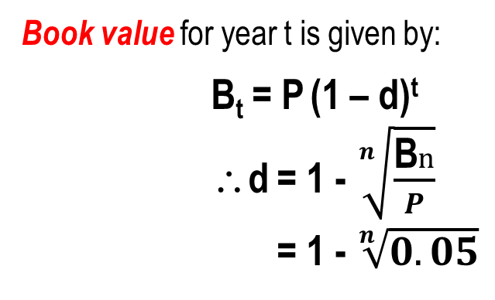
Declining Balance (DB) Depreciation
Determined by multiplying P at beginning of year by fixed percentage d
Book value for year t is given by:
B_{t} = P (1 – d)^{t}
∴d = 1 - $\sqrt[n]{\frac{\text{B}n}{P}}$
= 1 - $\sqrt[n]{0.05}$
Assume as if B_{n} = 5% of P
Where: B_{t} = Book value for year t
d = uniform depreciation rate
P = first cost or unadjusted basis

Slide 5
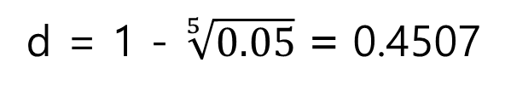
Example: Declining Balance
A depreciable construction truck has a first cost of
₩1.0M, 5 years of life. Find the (a) depreciation cost,
(b) book value after 3 years using DB depreciation.
Solution:
d = 1 - $\sqrt[5]{0.05}$ = 0.4507
year | Depreciation Cost | Book Value
0 |  | 1,000,000
1 | 450,720 | 549,280
2 | 247,571 | 301,709
3 | 135,986 | 165,723
4 | 74,694 | 91,028
5 | 91,028 | -

Slide 6
Taxation in Korea
Ⅱ. Corporate Tax Rate

Slide 7
Korea Corporate Tax Rates - 2021
If Taxable Income (TI) is:
Over, ₩M | But not over, ₩M | Tax is, ₩M and % | Of the amount over, ₩M
0 | 200 | 10% | 0
200 | 20,000 | 20 + 20% | 200
20,000 | 300,000 | 3,980 + 22% | 20,000
300,000 | No limit | 65,580 + 25% | 300,000
Income tax rates are graduated or progressive as TI increases
Each rate is the marginal tax rate for the TI range
Residence tax : 10% will be added
5 years of carry-forward (deficit)
Income deductions & exemptions by corporate tax law

Slide 8
Taxation in Korea
Ⅲ. After-Tax Economic Analysis

Slide 9
Tax Terms and Relations - Corporations
Gross Income GI or operating revenue R -- Total income for the tax year realized from all revenue producing sources including salvage value
Operating expenses OE -- All annual operating costs (AOC) and maintenance & operating (M&O) costs incurred in transacting business; these are tax deductible; depreciation and interests not included here
Income Taxes and tax rate T -- Taxes due annually are based on taxable income TI and tax rates, which are commonly graduated (or progressive) by TI level.
Taxes = tax rate × taxable income
= T × (GI – OE – D – I )
Net operating profit after taxes NOPAT – Money remaining as a result of capital invested during the year; amount left after taxes are paid.
NOPAT = taxable income – taxes = TI – T × (TI)
= TI × (1 – T)
Depreciation Cost
Interests

Slide 10
Income Tax Terms and Relations (Corporations)
Income taxes are real cash flow payments to governments levied against income and profits. The allowances of asset depreciation (noncash) and interests paid (cash) are used in income tax computations.
Two fundamental relations: NOI and TI
Net operating income = gross revenue – operating expenses
NOI = GI – OE (only actual cash involved)
NOI is also call EBIT(DA) (earnings before interest and taxes)
Taxable income = gross revenue – operating expenses
– depreciation – interests paid
TI = GI – OE – D – I
(involves noncash item)
Note: All terms and relations are calculated for each year t,
See Table 9-6 in Text material

Slide 11
Cash Flow After Taxes (CFAT)
NCF is cash inflows – cash outflows. Now, consider taxes and deductions, such as depreciation and interests paid
Cash Flow Before Taxes (CFBT)
CFBT = gross income – expenses – initial investment + Salvage
= GI – OE – P + S
Cash Flow After Taxes (CFAT)
CFAT = CFBT – taxes
= GI – OE – P – (GI – OE – D – I)(T_{e}) + S
since NOPAT=(GI – OE – D – I) – (GI – OE – D – I)(T_{e})
= (NOPAT + D + I) – P + S
A negative TI value is considered a
tax savings
for the project

Slide 12
Income Statements vs. Cash Flow
- Project View Cash Flow(ROI)
EBITDA=NOI
G
I
- Income Statements
NOPAT+D+I
0
EBITDA=NOI
G
I
D
E
B
T
O
E
I
T.I.
NOPAT
D
EQU
I
T
Y
T
O
E
0
I
D
T
See Table 9-6 in Text Material

Slide 13
Income Statements vs. Cash Flow
- Income Statements
- Stockholder View Cash Flow (ROE)
G
I
G
I
NOPAT+D-(Total Repayment)
EBITDA=NOI
T.I.
NOPAT
EBITDA=NOI
O
E
0
0
I
EQU
I
T
Y
O
E
D
T
I
D
T
PR.
Re
Payment

Slide 14
After-Tax ROE and ROI Calculation
ROI is rate of return on investment(or Project)
= GI – OE – P(Total Money) – Tax
= – P(Total Money) + EBITDA (Earning Before Interest, Tax, and Depreciation & Amortization) – Tax
= – P(Total Money) + NOPAT + Depreciation + Interest
ROE is rate of return on equity
= GI – OE – P(My money) – Tax – Amount of Repayment(Total)
= – P(My Money) + NOPAT + Depreciation – Total Repayment

Slide 15
Taxation in Korea
Ⅳ. Inflation

Slide 16
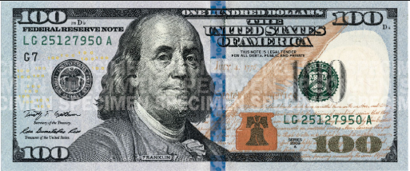
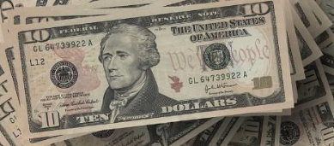
Actual $ vs. Constant $
Actual $ : expressed in the amount of $ bills that you are expected to have at year n
Constant $ : expressed in the amount of purchasing power as of year 0 that you are expected to have at year n
$100(Actual)
$100
0
n
year
$100(Constant)
+

Slide 17
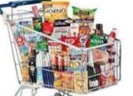

Constant $
Could be purchased with $100 at year 0
$100
0
n
year
Convert
+

Slide 18
Conversion from Constant $ to Actual $
(Inflation, f = 5%)
Period | NCF Constant $ | Conversion Factor | NCF in Actual $
0 | -$250.00 | (1+0.05)^0 | -$250.00
1 | $100.00 | (1+0.05)^1 | $105.00
2 | $100.00 | (1+0.05)^2 | $110.25
3 | $100.00 | (1+0.05)^3 | $115.76
4 | $100.00 | (1+0.05)^4 | $121.55
5 | $100.00 | (1+0.05)^5 | $127.63

Slide 19
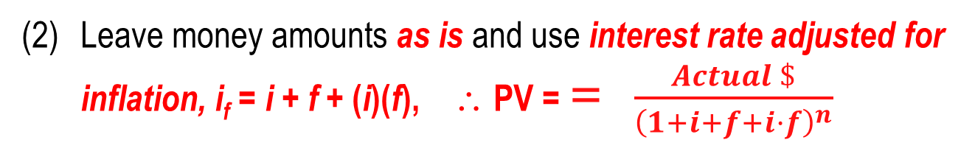
Understanding Inflation
Inflation: Increase in amount of money needed to purchase same amount
of goods or services. Inflation results in a decrease in
purchasing power, i.e., one unit of money buys less
goods or services
Two ways to work problems when considering inflation:
Convert to constant value (CV) dollars, then use real rate i
If f = inflation rate (% per year), the equation is:
Constant $ = $\frac{Actual \$}{{\left(1+f\right)}^{n}},$∴ PV = $\frac{Constant \$}{{\left(1+i\right)}^{n}}$ = $\frac{Actual \$}{{\left(1+f\right)}^{n}×{(1+i)}^{n}}$
Leave money amounts as is and use interest rate adjusted for inflation, i_{f} = i + f + (i)(f), ∴ PV = = $\frac{Actual \$}{{\left(1+i+f+i·f\right)}^{n}}$

Slide 20
Example: Constant Value Dollars
How much would be required today to purchase an item that increased in cost by exactly the inflation rate? The cost 30 years ago was $1000 and inflation has consistently averaged 4% per year.
Solution: Solve for future dollars
Future dollars = constant value dollars(1 + f)^{n}
= 1000(1 + 0.04)³⁰
= $3,243
Note: This calculation only accounts for the decreased purchasing power
of the currency. It does not take into account the time value of money
Deflation: Opposite of inflation; purchasing power of money is greater in future than at present; however, money, credit, jobs are ‘tighter’

Slide 21
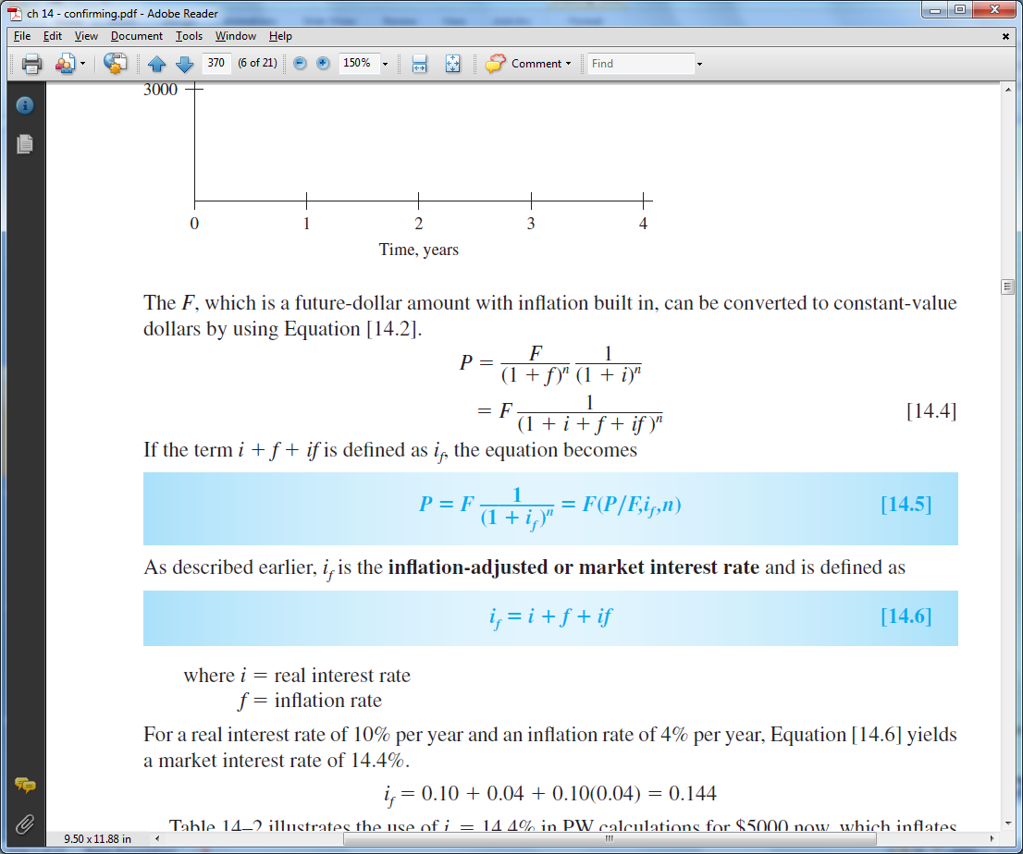
Three Different Rates
Real or inflation-free rate i – Rate at which interest is earned when effects of inflation are removed; i represents the real increase in purchasing power
Market or inflation-adjusted rate i_{f} – Rate that takes inflation into account. Commonly stated rate everyday
Inflation rate f – Rate of change in value of currency
Relation between three rates is derived using the relation
Market rate is: i_{f} = i + f + (i)(f)

Slide 22
Example: PW with Inflation
A honing machine will have a cost of $25,000 (future cost) six years from now. Find the PW of the machine, if the real interest rate is 10% per year and the inflation rate is 5% per year using (a) constant-value dollars, and (b) future dollars.
Solution: (a) Determine constant-value dollars and use i in PW equation
CV = 25,000 / (1 + 0.05)⁶ = $18,655
PW = 18,655(P/F,10%,6)
= $10,530
(b) Leave as future dollars and use i_{f} in PW equation
i_{f} = 0.10 + 0.05 + (0.10)(0.05) = 15.5%
PW = 25,000(P/F,15.5%,6)
= $10,530

Slide 23
Taxation in Korea
Ⅴ. Examples

Slide 24
Examples without inflation(Ex10-5)
Seoultech(Co) considering to invest a 5-years’ $10M(Initial Asset Investment)-project where $1M will be funded by equity and $9M by debt financing. The EBITDA of the project is estimated as $3M per year, and no salvage value is expected. Tax rate is assumed to be 40%, and Straight Line depreciation be applied. Interest rate for debt financing is 10% per year, and equal amounts of repayment are scheduled during 5 years.
Calculate After-tax ROI assuming no debt financing
Calculate After-tax ROI with debt financing
Calculate After-tax ROE with debt financing

Slide 25
Examples with inflation(Ex. 11-6)
Seoultech(Co) considering to invest a 4-years’ $10M-(Initial Asset Investment)-project. The EBITDA of the project is estimated as $4M per year(as of present’s constant dollar value), and no salvage value is expected. Tax rate is assumed to be 40%, and Straight Line depreciation be applied. Inflation rate is forecasted as 20% per year.
Calculate Before-Tax ROI with or without inflation
Calculate After-tax ROI assuming no inflation
Calculate After-tax ROI with inflation
Assume $1M by debt financing with 10% of interest rate for equal amount of repayment. Calculate After-tax ROE with inflation

Slide 26
Example 3. S Co. is planning to launch a new business in an attempt to increase operational margin in these depressed markets. This business requires 500billion won each in the beginning of the starting two years. The first 500 billion won (2022.1.1) which is coming from the earned surplus can be considered as an operational cost, while the 500 billion won (2023.1.1) in the next year, an acquisition cost(10 years of declining balance of depreciation with no salvage value), is to come from a debt financing by 5% interest rate with equal payment for 10 years.
The new service in this business is to be offered from new years day in 2023. Number of subscribers is forecasted as 500,000 at the starting year and will be increased by 100,000 each year until it reaches 1Million and stays there. ARPU (Average Revenue Per User) is estimated as 20,000won each month, and operational expense, as 10% of the revenue excluding the depreciation cost.

Slide 27
Assume that revenue and expenses occur at the end of each year. Tax rate is 35% of the taxable income.
1) Calculate the depreciation cost in each year.
2) Calculate the interest payment in each year
3) How much is the after-tax-ROI?
4) How much is the after-tax-ROE?
5) If the inflation rate is 5% per year, How much is the after-tax-ROI? Assume that all the price is current price.

